Slide 1
City of Sparks Update Mike Kazmierski, President and CEO September 14, 2020

Slide 2
What Is EDAWN ?
Economic Development Authority Of Western Nevada
Non-Profit That Leads Economic Development Efforts Of The Region
Mission To Attract / Retain & Grow Quality Jobs
One Of Seven - State Development Authorities
A Community Board With Members From: Government, Business, Education & Partners
Area Of Responsibility - Metro Area to Fernley
Notes:
Just a reminder – EDAWN is a non profit and depends primarily on our major investors for our support.
We are responsible for the Reno-Sparks MSA and the I-80 corridor out to Fernley.

Slide 3
EDAWN’s Strategic Plan
Workforce Development
Entrepreneurial
/ Startup Growth
Attraction
Retention / Expansion
Community Development
3
Notes:
What’s new is that the three teams are more coordinated and integrated than ever.

Slide 4
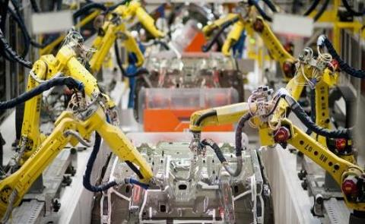
2020 Attraction Priorities
Higher Paying Jobs, Half Over $40 / Hr.
Corporate Headquarters
Technology Companies
Joint Entrepreneurial / Attraction Campaign
Increase Prospects From The Bay Area
Notes:
Our priorities for attraction are essentially the same as last year.
Higher paying jobs and HQs
While All three of our teams are working on a Bay Area Attraction Campaign

Slide 5
Sector Transition Distribution to Technology
Notes:
Here is the trend and you can see our focus on high paying technology companies over the past few years is paying off.

Slide 6
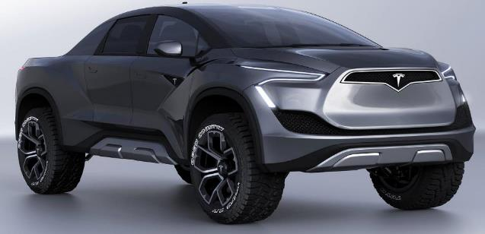
Technology Growth In The Region
New
Tesla
Apple
Bombora
Koch
Alchemy
Figure
Google
Clear Capital
Switch
Many Others
Notes:
Speaking of technology companies - Can you imagine telling some one just 6 years ago, that Reno-Sparks is home to these great companies?

Slide 7
COVID – 19 Impacts
This Photo by Unknown Author is licensed under CC BY-ND

Slide 8
Diversification = Less Volatility
Reno - Sparks
Same As Vegas
Notes:
You can see that we are out of available workforce with full employment at around 4%. So that means we must upskill our existing workforce
And attract more talent to the region

Slide 9
Local Revenue – Month over Month Combined Sales & Use Taxable Sales
Washoe County Positive After Two Months

Slide 10
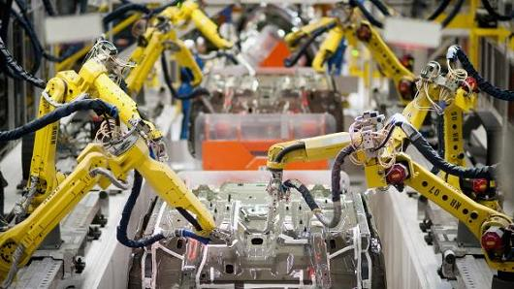
Post COVID-19 Attraction Priorities
Higher Paying Jobs Majority Over $30 / Hr.
Corporate Headquarters & Technology Co’s
Entrepreneurial Team Attraction Effort
Increase Prospect Attraction From The Bay Area
Pharma, Medical Manufacturing & Onshoring
Remote Workforce Talent Attraction
Notes:
Our priorities for the coming year include a continued emphasis on more higher paying technology jobs.
We have reduced the jobs goal to 2,250
More time and effort in getting Bay Area companies, entrepreneurs and talent to consider our region
Advanced Manufacturing will remain a priority

Slide 11
Pending Announcements
Industry | Jobs | HQ | Confidence | Relocation State
Technology | 50 | X | Very Likely | CA
Manufacturing | 205 | X | Very Likely | CA
Manufacturing | 220 |  | Very Likely | MI
Distribution | 250 |  | Very Likely | IL
Distribution | 150 |  | Very Likely | NY
Manufacturing | 20 | X | Very Likely | CA
Manufacturing | 159 |  | Very Likely | CA
Manufacturing | 20 |  | Very Likely | INTL
Manufacturing | 300 |  | Very Likely | CA
Technology | 400 |  | Very Likely | MA
Total | 1,774 | 3

Slide 12
Pipeline
Jobs - 4,790
HQ - 12
Manufacturing - 15
Technology - 8
Distribution and E-commerce - 6

Slide 13
August 2020
August 2020
1 Company Relocation
400 New Jobs Added
Record 42 New Leads & Projects
6 Site Visits

Slide 14
Prior EDAWN Sparks Projects
Industry | Company | Jobs | From
Manufacturing | Cam-Concept | 10 | INT
Logistics | ITS Logistics | 55 | NV
Manufacturing | Revision Brewing | 45 | CA
Manufacturing | Hose Master | 30 | OH
Manufacturing | Indy Hanger | 20 | IN
Manufacturing | NOW Foods | 47 | IL
Manufacturing | Cenntro Automotive Co | 300 | NJ
Manufacturing | Eco Windows LLC | 17 | NV
Distribution | Orest Express | 30 | IL
Distribution | SanMar Corporation | 90 | NV
Manufacturing | Tecno Displays | 30 | CA

Slide 15
Prior EDAWN Sparks Projects
Industry | Company | Jobs | From
Manufacturing | Mechman Alternators | 15 | TN
Support Services | Cashman Equipment | 15 | NV
Manufacturing | Havelock Wool | 15 | NZ
Manufacturing | HC Companies | 150 | OH
Distribution | South/Win | 20 | NC
Logistics | Alfa Aesar | 15 | MA
Manufacturing | NeoMedical | 12 | CA
Dist/Logistics | Allergy Be Gone | 15 | NY
Dist/Logistics | Walkenhorst’s | 217 | CA

Slide 16
Prior EDAWN Sparks Projects
Industry | Company | Jobs | From
Manufacturing | American Dunnage | 35 | INT’L
Manufacturing | Marathon Industries | 50 | CA
eCommerce/Manuf | Yogo | 40 | CA
Manufacturing | Haida Industries | 40 | INT’L
Manufacturing | AeroSafe Gbl (Sp Springs) | 75 | NY
Manufacturing | Deantronics (Sp Springs) | 100 | INT’L
Manufacturing | Monin (Sp Springs) | 30 | FL
Logistics | Ellsworth (Sp Springs) | 33 | CA
Logistics | Fox Racing (Sp Springs) | 60 | CA
Manufacturing | Confidential (Sp Springs) | 14 | CA

Slide 17
EDAWN's Goals – Retention / Expansion
• Why Is This So Important?
Majority Of New Jobs Come From The Expansion Of Existing Companies
Our High Growth Companies Are Being Courted By Other Communities
Efforts To Keep Existing Industry Also Improves The Region - So Attraction Is Easier
Working With Existing Companies Provides Connections And Opportunities For Attraction
Notes:
Here are just a few of the many things we do to assist our local industry
For anyone in Sales, it is easier to retain your existing customers than it is to attract new ones!

Slide 18
Workforce Program – What We Do
Guide Workforce & Community Partners To Meet The Current And Future Needs Of Our Employers
Connection
Education Pipeline
Employer
Needs
Attraction
Upskilling Incumbent Workers
Notes:
Workforce Development and attraction Is Key to our Future - So Here is a good summary of what we do
With current and future employer needs as our focus
1. we connect the workforce ecosystem to the employers.
2. Work with the education providers
3. Attract talent to the region and
4. Help to upskill the existing workforce so they can transition to the jobs of the future.

Slide 19
EDAWN Workforce Program – How We Do It
Workforce Partners
Employers
Employees
Research
Inform
Connect
Support
Create
PK-12
Post-Secondary
Government
Notes:
This is how we will do it
Working with our partners:
Conduct Research And Assemble And Analyze Data
Inform Stakeholders
Encourage And Strengthen Connections
Support Initiatives That Fill Gaps
Create programs and Material to address WD needs

Slide 20
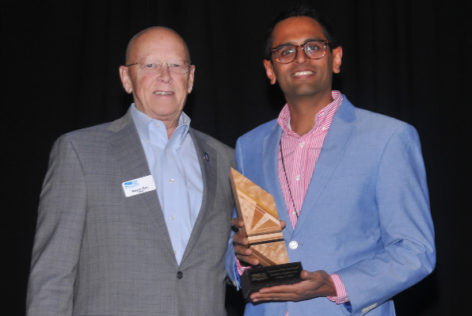
Retention-Expansion-Workforce
Connect with Primary Companies
Introduce To Resources
Remove Roadblocks
Drive Business to Business Connections
Implement Workforce Plan
20
Recognize Achievements:
Davidsons Organics Teas
Small Company of The Year
Thanks To The BREWD Team !
Notes:
The BRE-WD Team is primarily focused on taking care of existing companies
As you know many of the existing and even our new companies have workforce as their top issue.
Thanks to Nancy, Amy, Cynthia & Millie

Slide 21
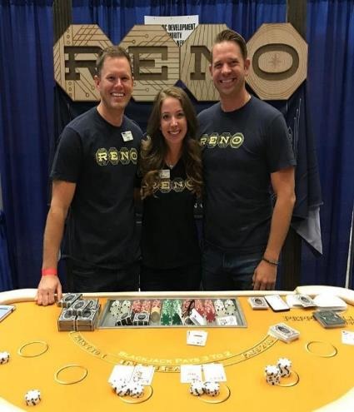
Entrepreneurial Successes In 2019
143 NEW Startup Jobs
37 NEW Companies
$122M In NEW Funding
Big Wins:
Thanks To The Entrepreneurial Development Team !
Notes:
Thanks to Doug, Bryan, Katie and our newest intern Omar
We continue to make great progress in growing our ecosystem
143 jobs may not seem like much to Stan when he brings in thousands of jobs, but any one of these new companies could be the next Tesla
Now that we have an ecosystem that is viable and somewhat developed we are shifting to a more aggressive program of attracting High Tech / High Growth Startups especially from The Bay Area

Slide 22
2020 Goal: Tech Attraction
Objective:
Increase Startup Density & Founder Engagement
Increase High Wage / High Skill Jobs
Focus:
Attracting Tech Startups From Bay Area
How:
Highly Targeted Direct Marketing Campaign
Bay Area Focused Events (VC’s & Founders)
Notes:
We have three areas we are putting extra emphasis on in the coming year.
The first Is tech Attraction
The ED Team is working with the other teams on the Bay Area attraction effort to help more of the start-ups and smaller technology companies consider Reno as a place to grow.

Slide 23
2020 Goal: Ecosystem Support
Reno Startup Deck
StartupReno.org
Collaboration & Events
- Founder Dinners
New Accelerator Program
Support Entrepreneurial Organizations:
Notes:
The second area of focus is the ecosystem support and development.
You see the Ace of Hearts on you table, that represents the start-up deck which provides a visual of the ecosystem with contact information.
We will ask you to use that to help us promote the ecosystem to others

Slide 24
2020 Goal: Investment
Reno Seed Fund
$2.5 Million Fund
Invested Over $2 M In 6 Companies
Most Notably: BlocWatch, Breadware, Panty Drop And Clickbio
Notes:
The Third area of focus is funding and helping our start-up get the funding they need to get to the next level.
With the help of Gene Wong and others we launched the Reno Seed Fund
To give more start-up companies a little push in their development
and to attract start-ups to the region

Slide 25
Community Challenges – To Address
Workforce / Affordable Housing
Downtowns Development
Education Funding
Infrastructure Upgrades
Homelessness
Notes:
So we can expect growth to continue and our economy is more diversified than ever but what can we do to keep this train on the tracks?
Here are a few things we need to consider
(25 more slides)

Slide 26
Greatest Challenge Affordable Housing
Fewer Housing Units Than We Need
Not Just Here – But A National Problem
Housing Shortage Impacts:
Drives Up Prices
Forces Low Income Citizens Out
Increases Sprawl And Traffic
Increases Homelessness
Less Attractive
Notes:
It is really a supply and demand issue but the impacts go well beyond housing
This is a problem everywhere

Slide 27
New Housing In Washoe County – Past 20 Yrs
Multifamily
Notes:
This provides a great view of our housing situation.
Thanks to Brian Bonnefant and the Center for Regional Studies for the data.
First, we are building far fewer housing units now than before the recession even though our population has grown by 40%.
Second, we are adding more multifamily apartments than ever and there are several more in the pipeline so that will increase.
Finally, we are not really adding much missing middle housing, condos, townhomes and four plexes etc.

Slide 28
Lands Bill Helps Housing, Industrial Land And Traffic

Slide 29
Community Development Initiatives
Funding For School Infrastructure – WC-1
Downtowns Revitalization – Start-Up Row
Arts and Culture – Art Map; Business & Arts
Housing Crisis – Developers Workshop
Regional Trails Coordinated Planning
Traffic Issues On I-80 (Transit & Capacity)
Regional Flood Control – TR Needs Committee
Eddy House – Training Facility Homeless Youth
Transitional Housing Dorms on Sage Street
Regional Land’s Bill

Slide 30
Regional Public / Private Partners
City of Reno | UNR | State Offices
City of Sparks | TMCC / WNC | Nevada JobConnect
City of Fernley | DRI | Nevadaworks
Washoe County | The Chamber | NNDA
Storey County | WNDD | NV Energy
Washoe County School District | NCET | Reno-Tahoe Airport Authority
GOED | RTC | Investors
DETR | RSCVA | Many Others !
30
Notes:
Successful economic development is a partnership and EDAWN works region-wide with numerous collaborators, on various aspects of business recruitment, expansion and job creation.
A special thanks to our elected officials from our Governor who has been personally involved in many of our deals and was key to the Tesla decision to our legislators and local elected officials – Let’s give them all a round of applause!

Slide 31
EDAWN Partners In Sparks
EDAWN has partnered with NOW FOODs to provide assistance with workforce development, community connections and operations….We value our partnership with EDAWN - Mardie Crawshaw HR
We are grateful for EDAWN’s efforts to represent the business community, forge networks between employers and the talent pipeline, and preserve the special spirit of northern Nevada. Brooke Hart – Director of Communications

Slide 32
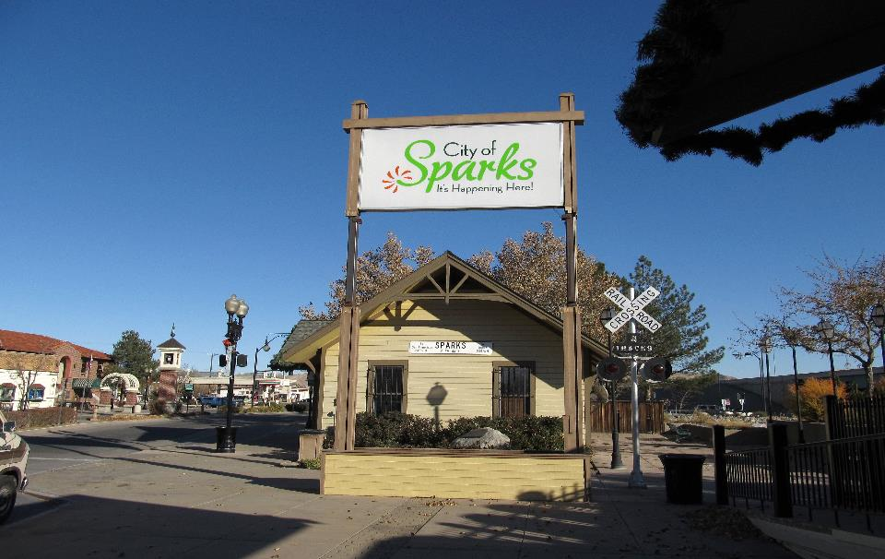
Request City Of Sparks Retain Funding Support For EDAWN At Current Level
Questions?

